Slide 1

Pawdopter Mobile Application associated with IoT Device for potential Animal Adopters to find their Pet to love
Paula Carine Oehme 2957903
Sarah Narayamy Tavares Silva 2960992

Slide 2
Problem Definition
To define our problem we must first visualize the importance of the relationships with pets over the years. This relationship have evolved from been tools for protection of household, labor in the early days and now they are pets and a huge number is considered as family members.
Different reasons are cause to abandonment of animals and the difficulty of finding the desired pet to adopt.
We found numbers from the department of Rural and Community development in 2018 that shows that over 132 thousands of dogs entered pounds all over Ireland, from those more than 29 thousand were euthanized because they couldn’t find them a new home, that’s an average of 21% per year;
There is also a lack of tools and campaigns to increase the adoption rate.

Slide 3
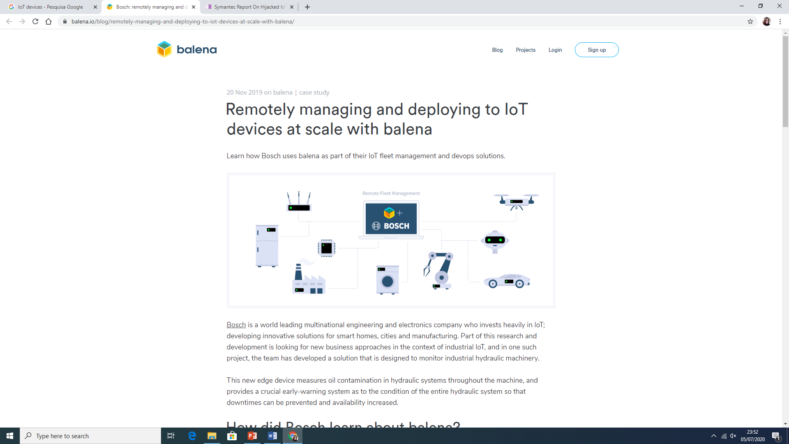
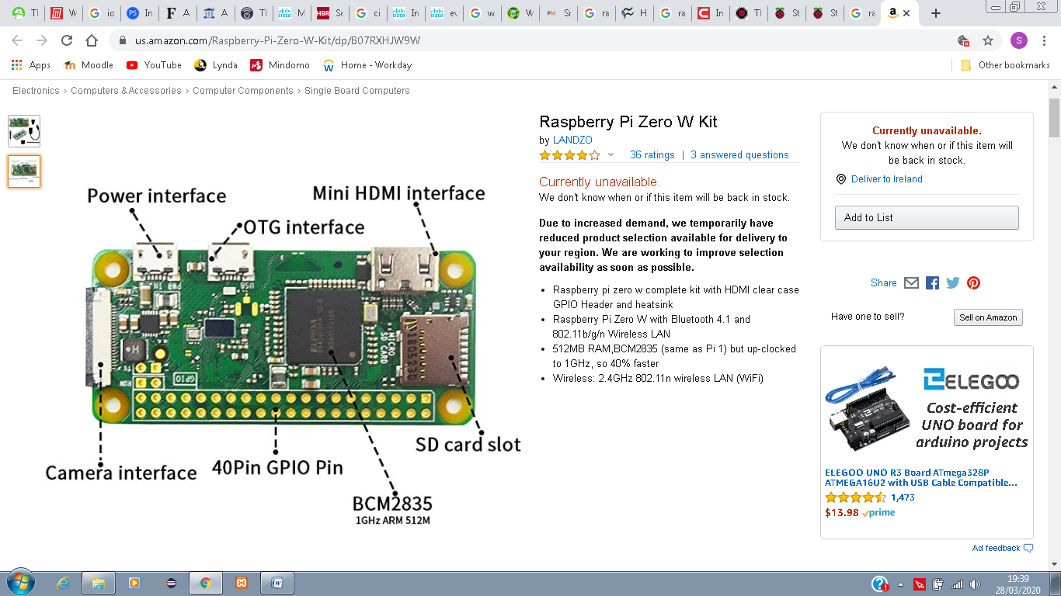
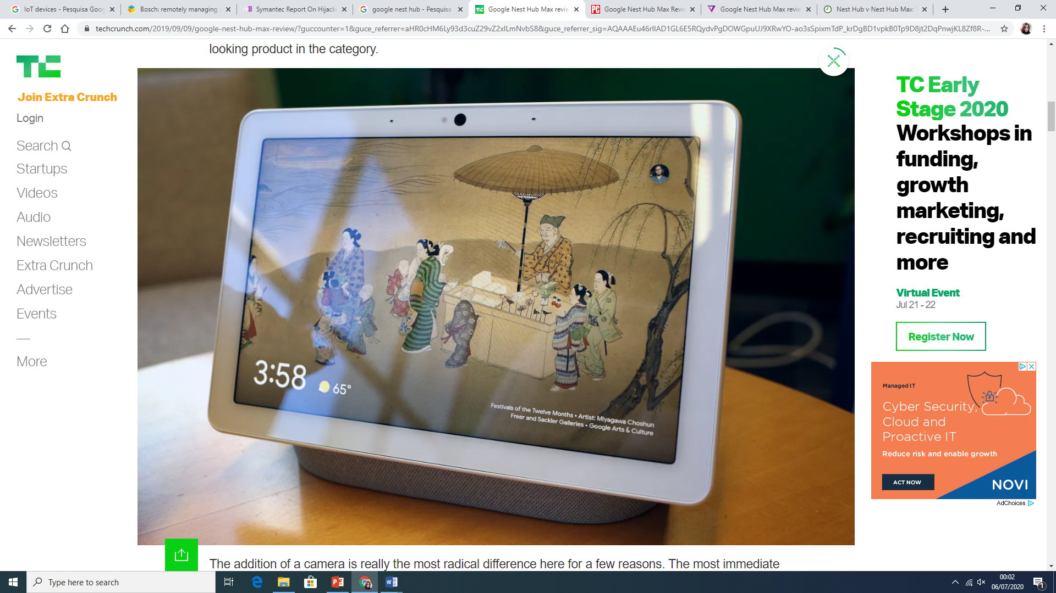
IoT – Internet of Things
In this case we are going to focus on smart home devices.
Ordinary objects stops being just ordinary by adding connectedness into them.
Their main features are Wireless technology such as Bluetooth, Radio frequency Identification, Wi-Fi, sensors.
Raspberry Pi/ Arduino.
Google Home/ Amazon Alexa.
GPIO (General purpose input/output)

Slide 4
Project Goal
Research in the field of animal adoption in Ireland;
Research the use of IoT devices;
Create a mobile application with specific functionalities;
Integrate the mobile application with Google Home device (Google Assistant);
Provide facilitate tool for potential adopters to find a pet by using filters.

Slide 5
Project Scope
To create a mobile application that will benefit potential adopters in their search for a pet to love;
Use of command voice to find the desired pet;
Use of filters to find a pet with determined characteristics;

Slide 6
Project Objectives
Perform secondary research on the topic;
Perform primary research using mixed methodology (Quantitative and Qualitative);
Prepare conceptual model based on the results of the Primary and Secondary researches;
Design, Code, and Test application;
Integrate application with Google Home Assistant;
Perform User evaluation of the developed application;
Analise results;
Complete and present Thesis.

Slide 7
Project Gant Chart

Slide 8
Chosen Research and Development Methodologies for the project
Mixed research method:
Quantitative
Qualitative
Dynamic Software Development Method (DSDM)
Time Boxing (time management technique in which you allot a fixed, maximum unit of time for an activity in advance, and then complete the activity within that time frame.)
MoSCoW technique
Prototyping

Slide 9
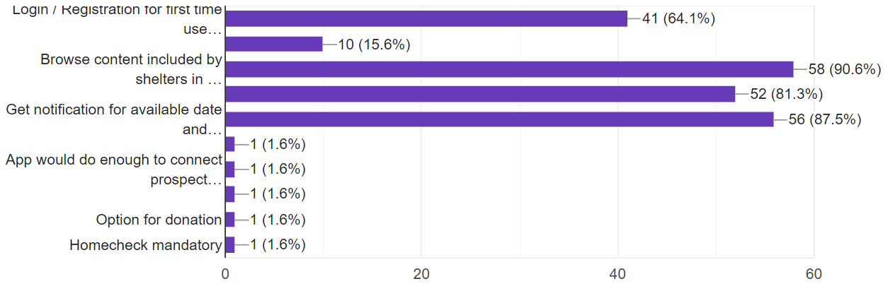
System Requirements:
Use of IoT device
Fill adoption intent form

Slide 10
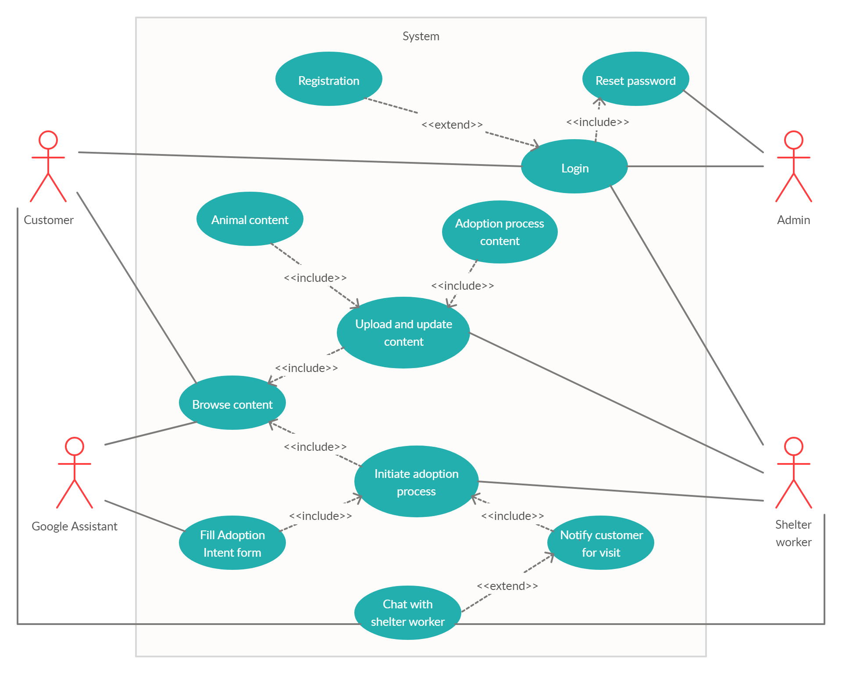
Use Case Diagram

Slide 11
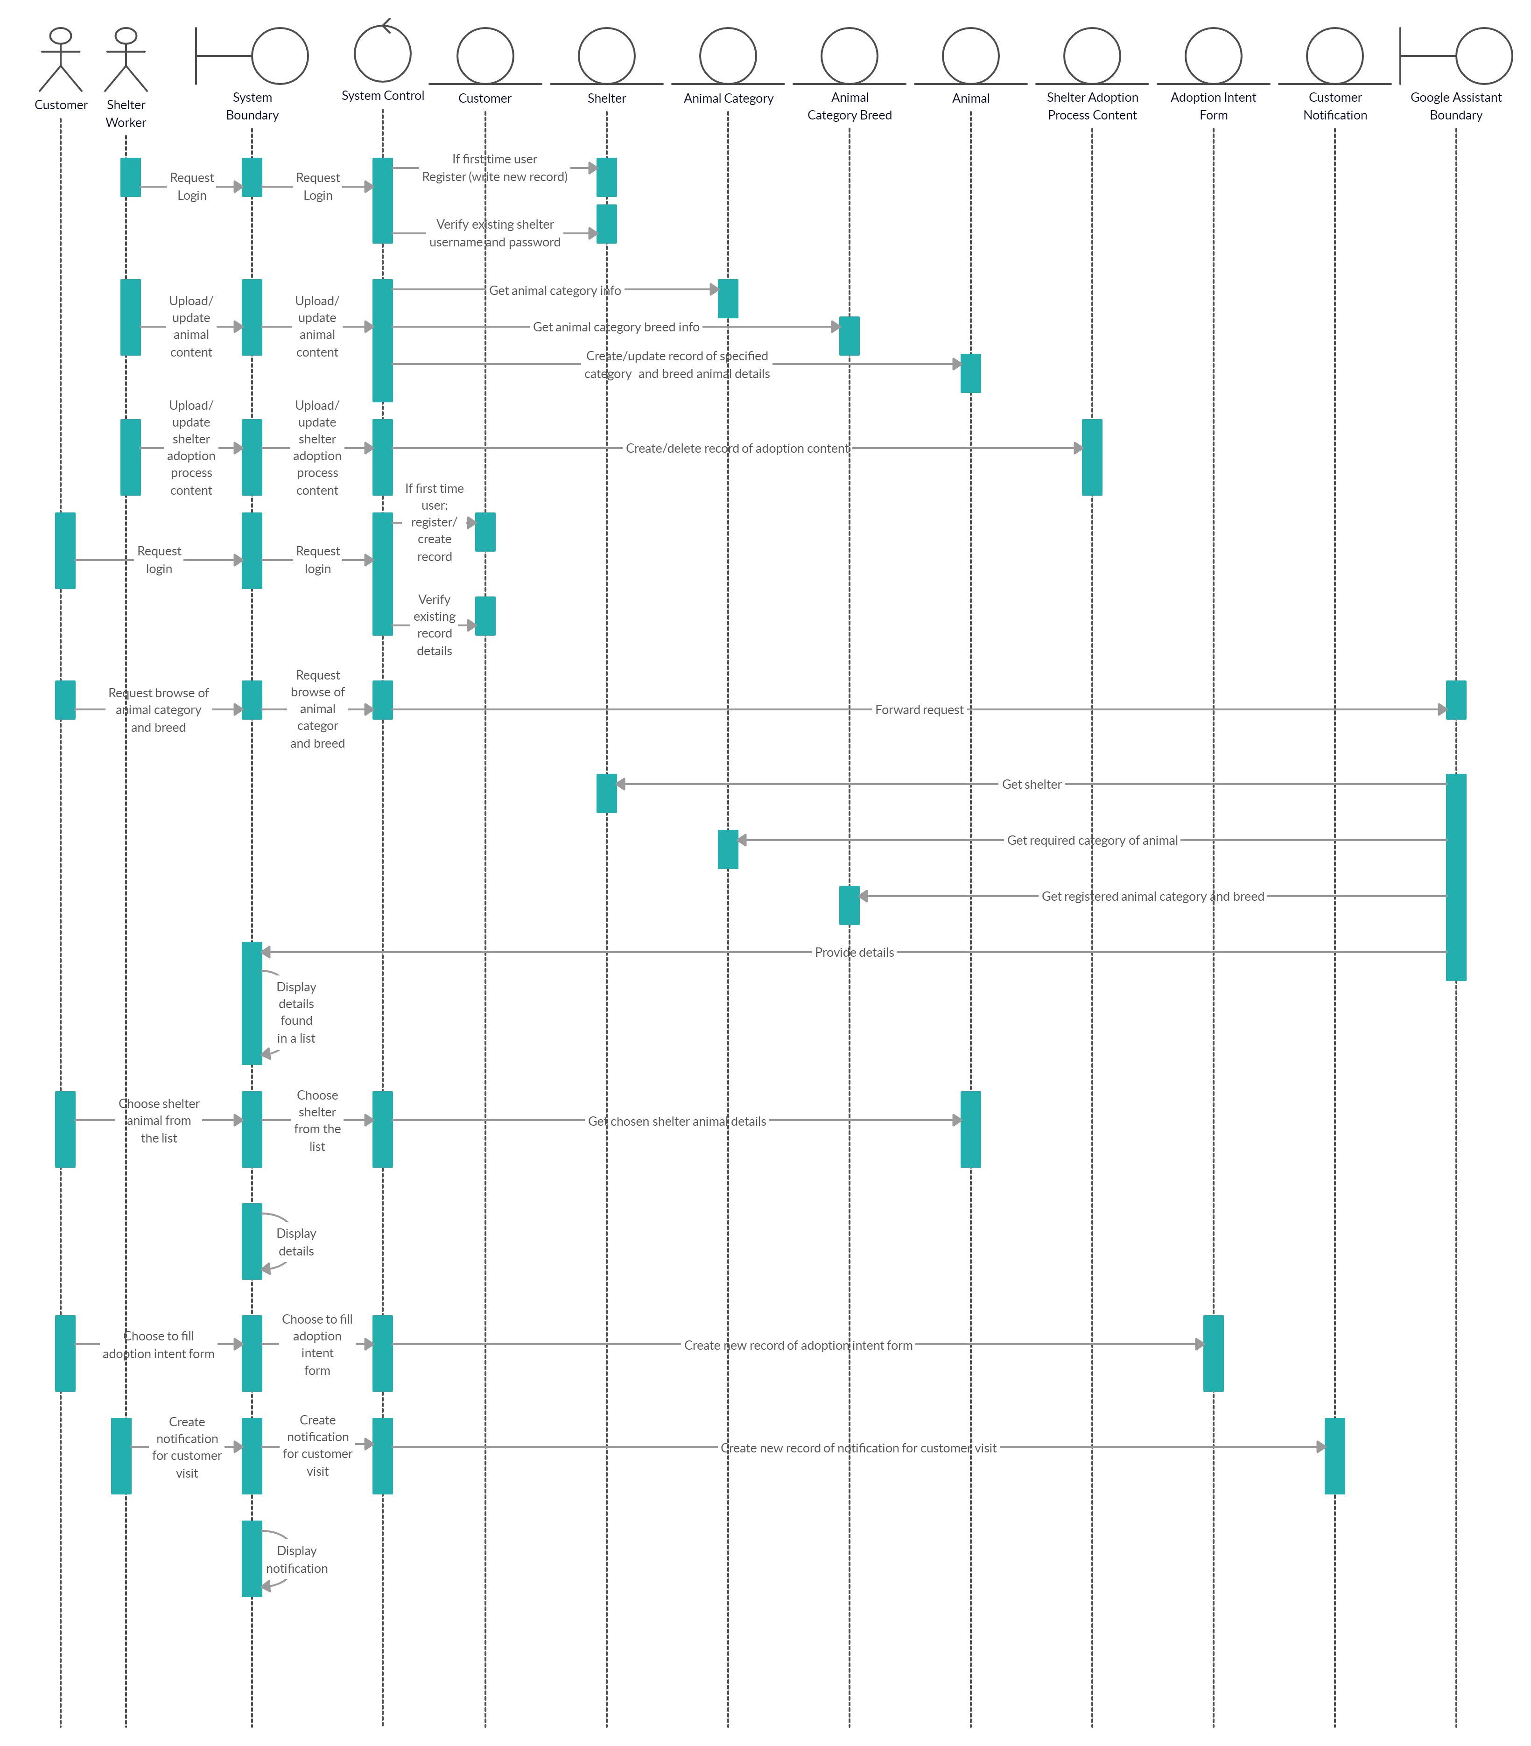

Slide 13
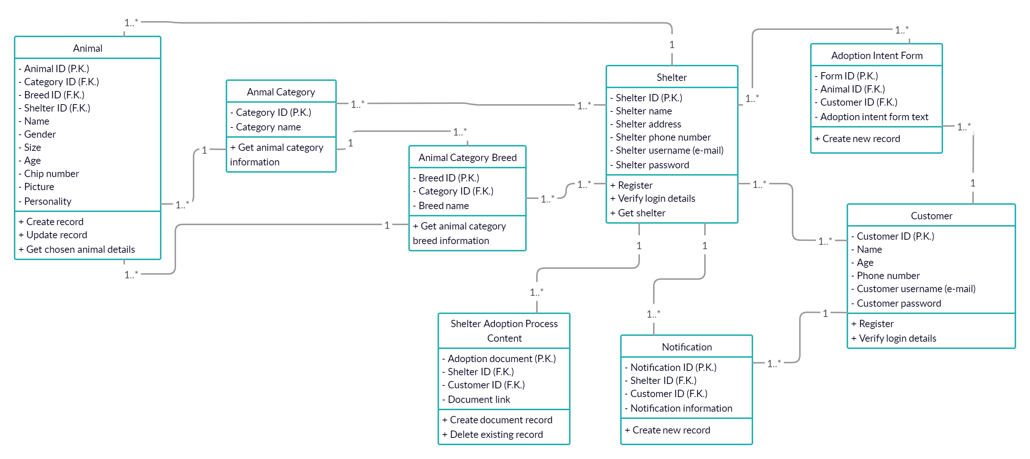
Object Class Diagram

Slide 14
Alternative Solutions
Low-End Solution | Mid-Range Solution | High-End Solution
Login/ Registration Reset Password Browse Content | Login/ Registration Reset Password Browse Content Fill adoption intent form Initiate adoption process Notify user for visit | Login/ Registration Reset Password Browse Content Fill adoption intent form Initiate adoption process Notify user for visit Live chat with shelter worker

Slide 15
Screen Designs

Slide 16
Screen Designs cont.

Slide 17
Database Relationships

Slide 18
Database Connectivity

Slide 19
Database Connectivity cont.

Slide 20
Database Connectivity cont.

Slide 21
Database Connectivity cont.

Slide 22
3-Tier Architecture
Presentation Tier
Application Tier
Database Tier

Slide 23
Testing
White-Box Testing | Black-BoxTesting | Grey-Box Testing
Tests the internal structure, the design and implementation of the solution; Tester chooses the inputs; Can start at an early stage; It is very thorough and covers most paths; Needs highly skilled personnel; Can be burden since changes are too frequent; Expensive. | Tests the behaviour/functionalities; Tester does not know the Structure, design and implementation of the software; Works a black-box in the eyes of the tester; Done from the users’ point of view; No need for programming knowledge; Can leave program paths untested; Difficult to design testing cases if there are no clear specifications; Redundancy. | Black and white box testing combined; Internal structure is known firstly to design test cases; Test is done from the users’ point of view; No need for high programming knowledge; Unbiased; More effective in integration testing Not exhaustive; Ideal for projects with limited time frame.

Slide 24
Testing Cases
Action | Expected result | Pass | Fail | Actual result
Open application | Initial screen opens if user has not registered and logged in, otherwise main screen opens |  |  | Initial screen is displayed if user has not registered and not logged in. Main screen is displayed otherwise
Select Register option | Registration screen opens |  |  | Registration screen is displayed
Register button pressed without any data entered | Display error message to enter data for each field |  |  | Error message is displayed in each field, asking user to enter data
Register button pressed when invalid data is entered | Display specific error message to each field where data is invalid, guiding the user on how to fix it |  |  | Specific error message is displayed to each field where data is invalid, guiding the user on how to fix it
Register button pressed with valid data entered in all fields | Create new user and open main screen |  |  | New user is created, and main screen is displayed
Select Login option | Login screen opens |  |  | Login screen is displayed
Login button pressed without any data entered | Display error message to enter data |  |  | Error message is displayed in each field, asking user to enter data
Login button pressed when invalid data is entered | Display specific Toast message, regarding the error |  |  | Specific Toast message regarding the error is displayed

Slide 25
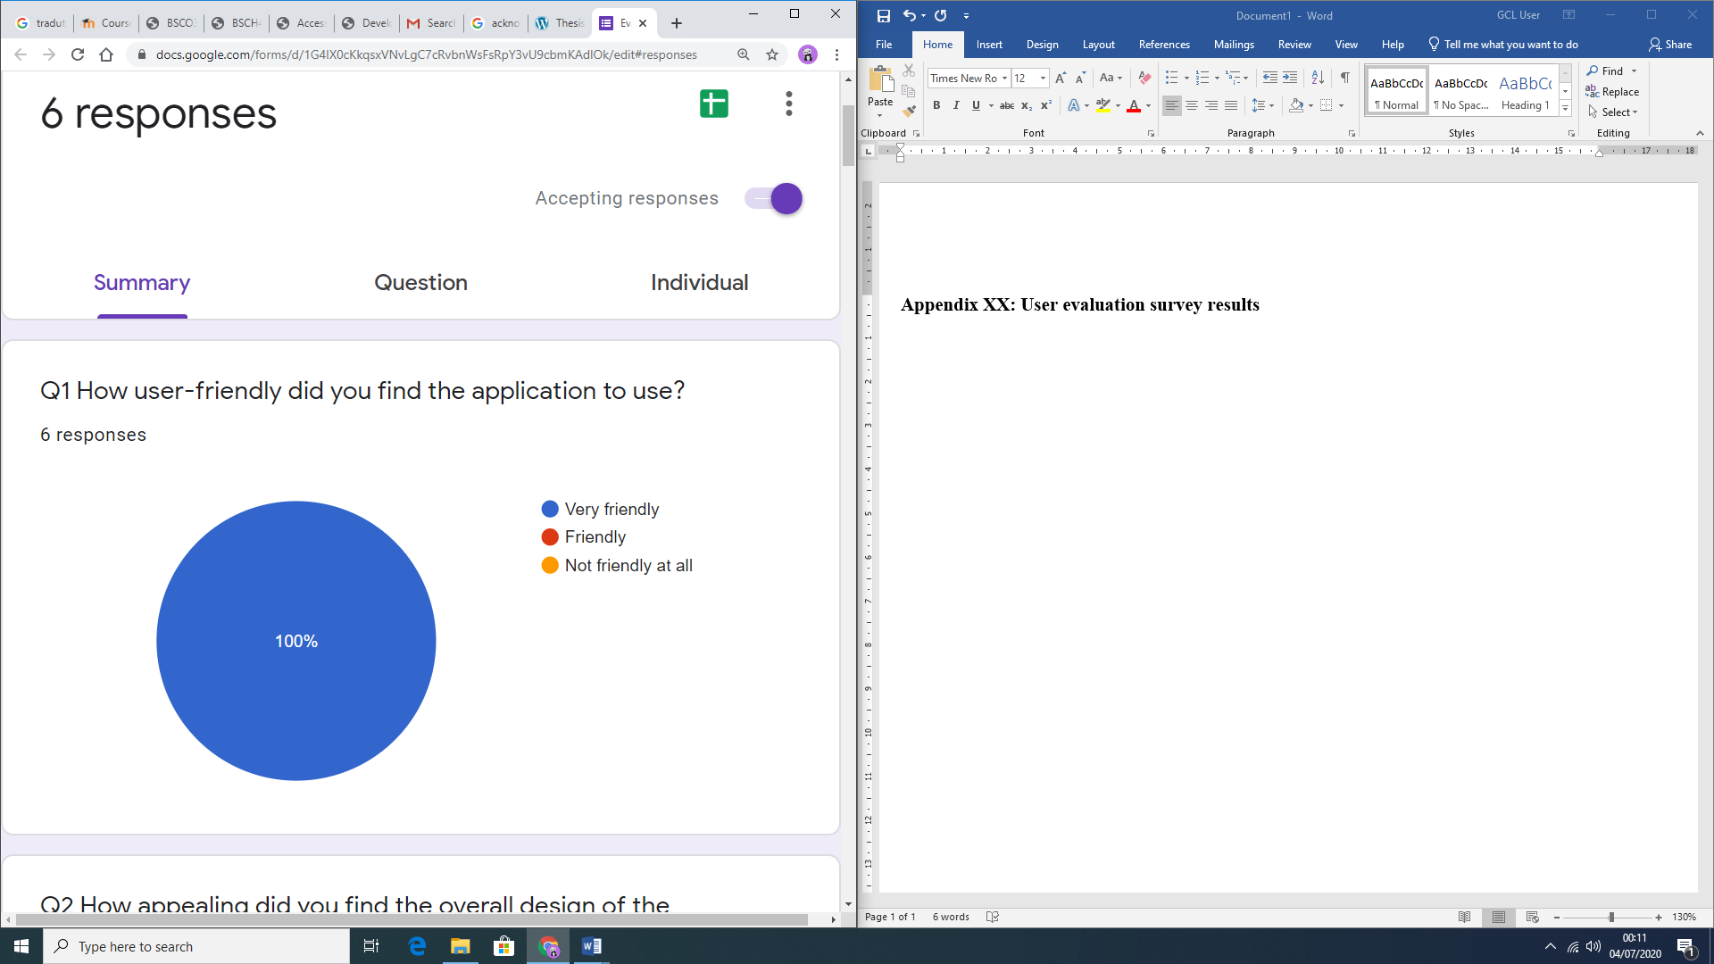
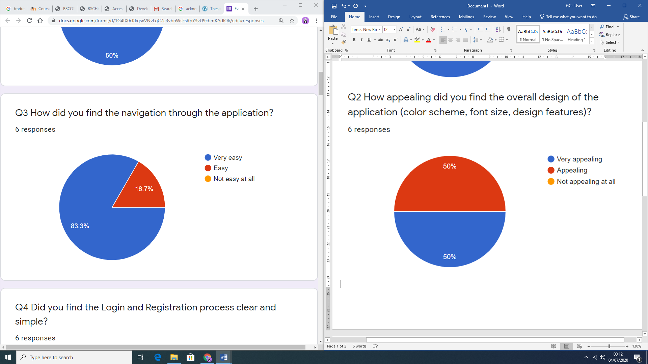
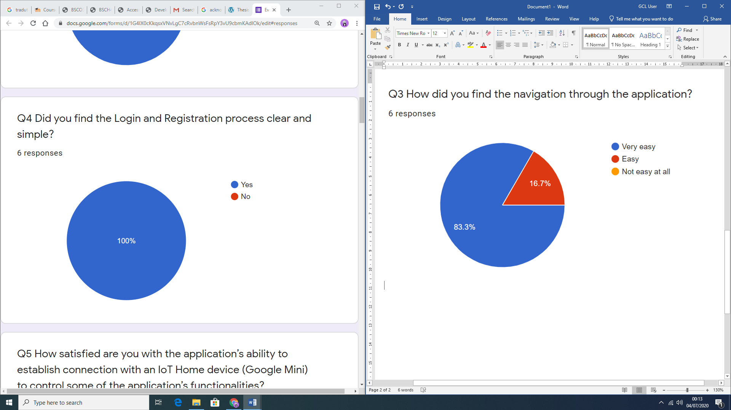
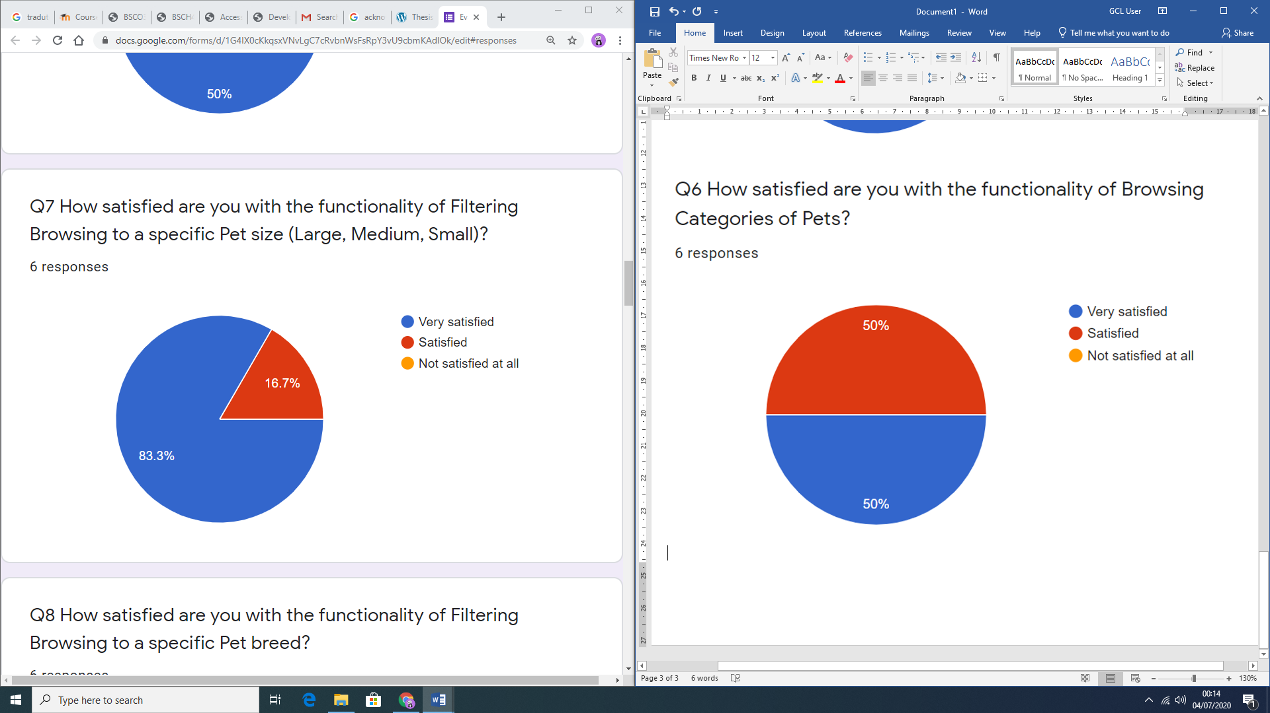
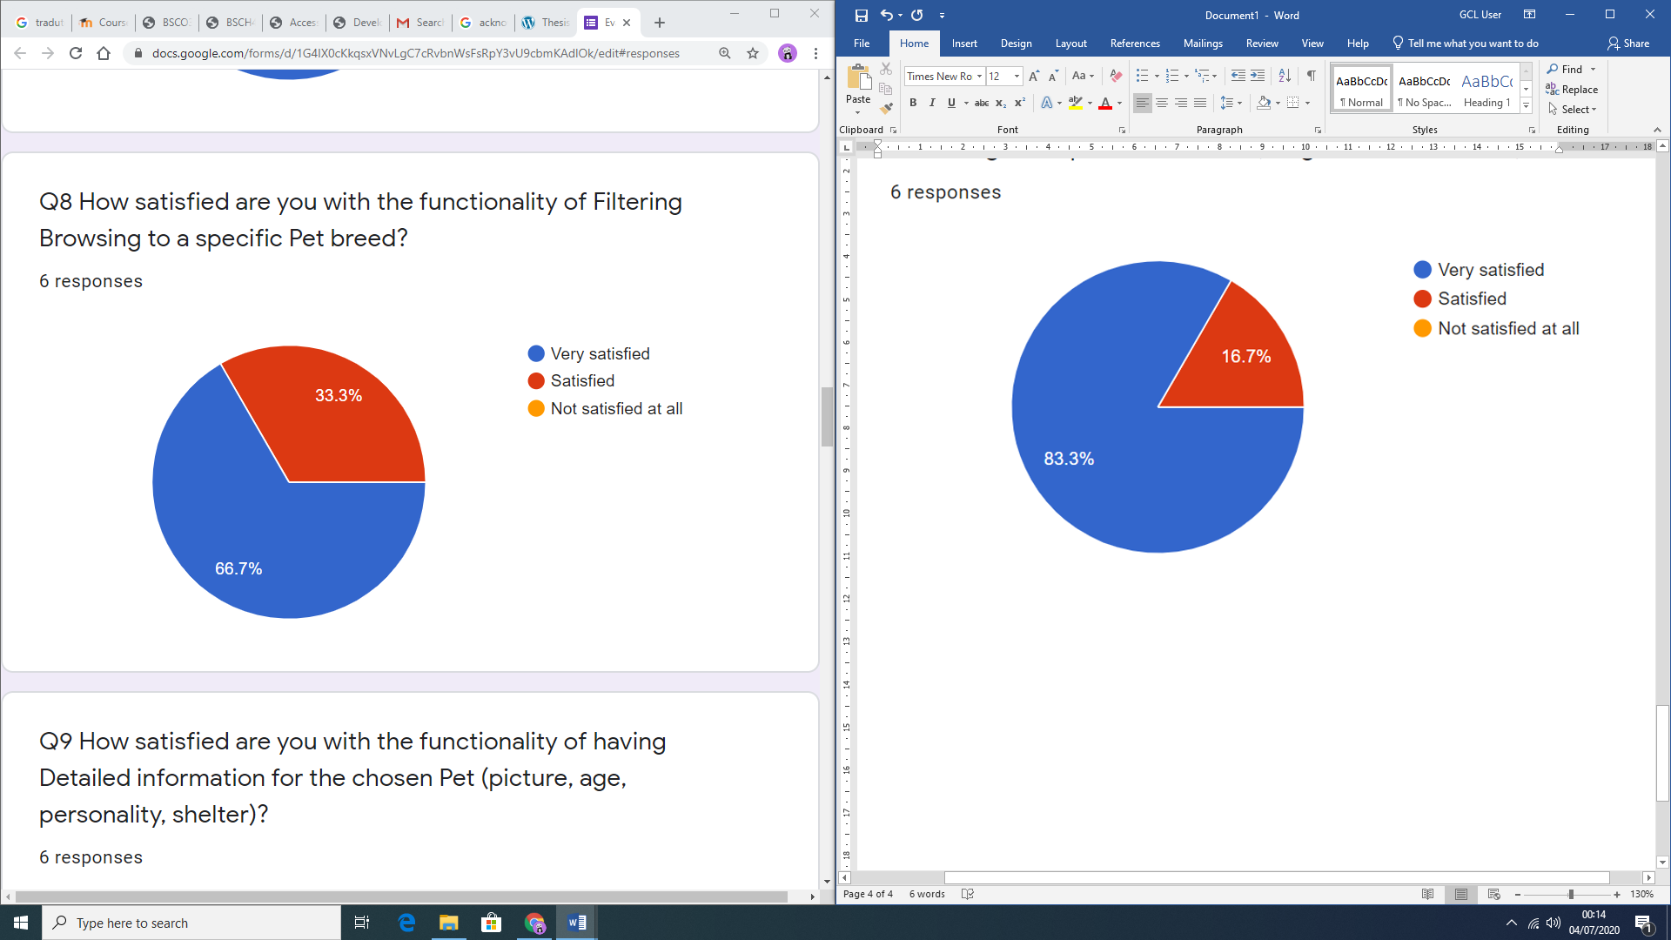
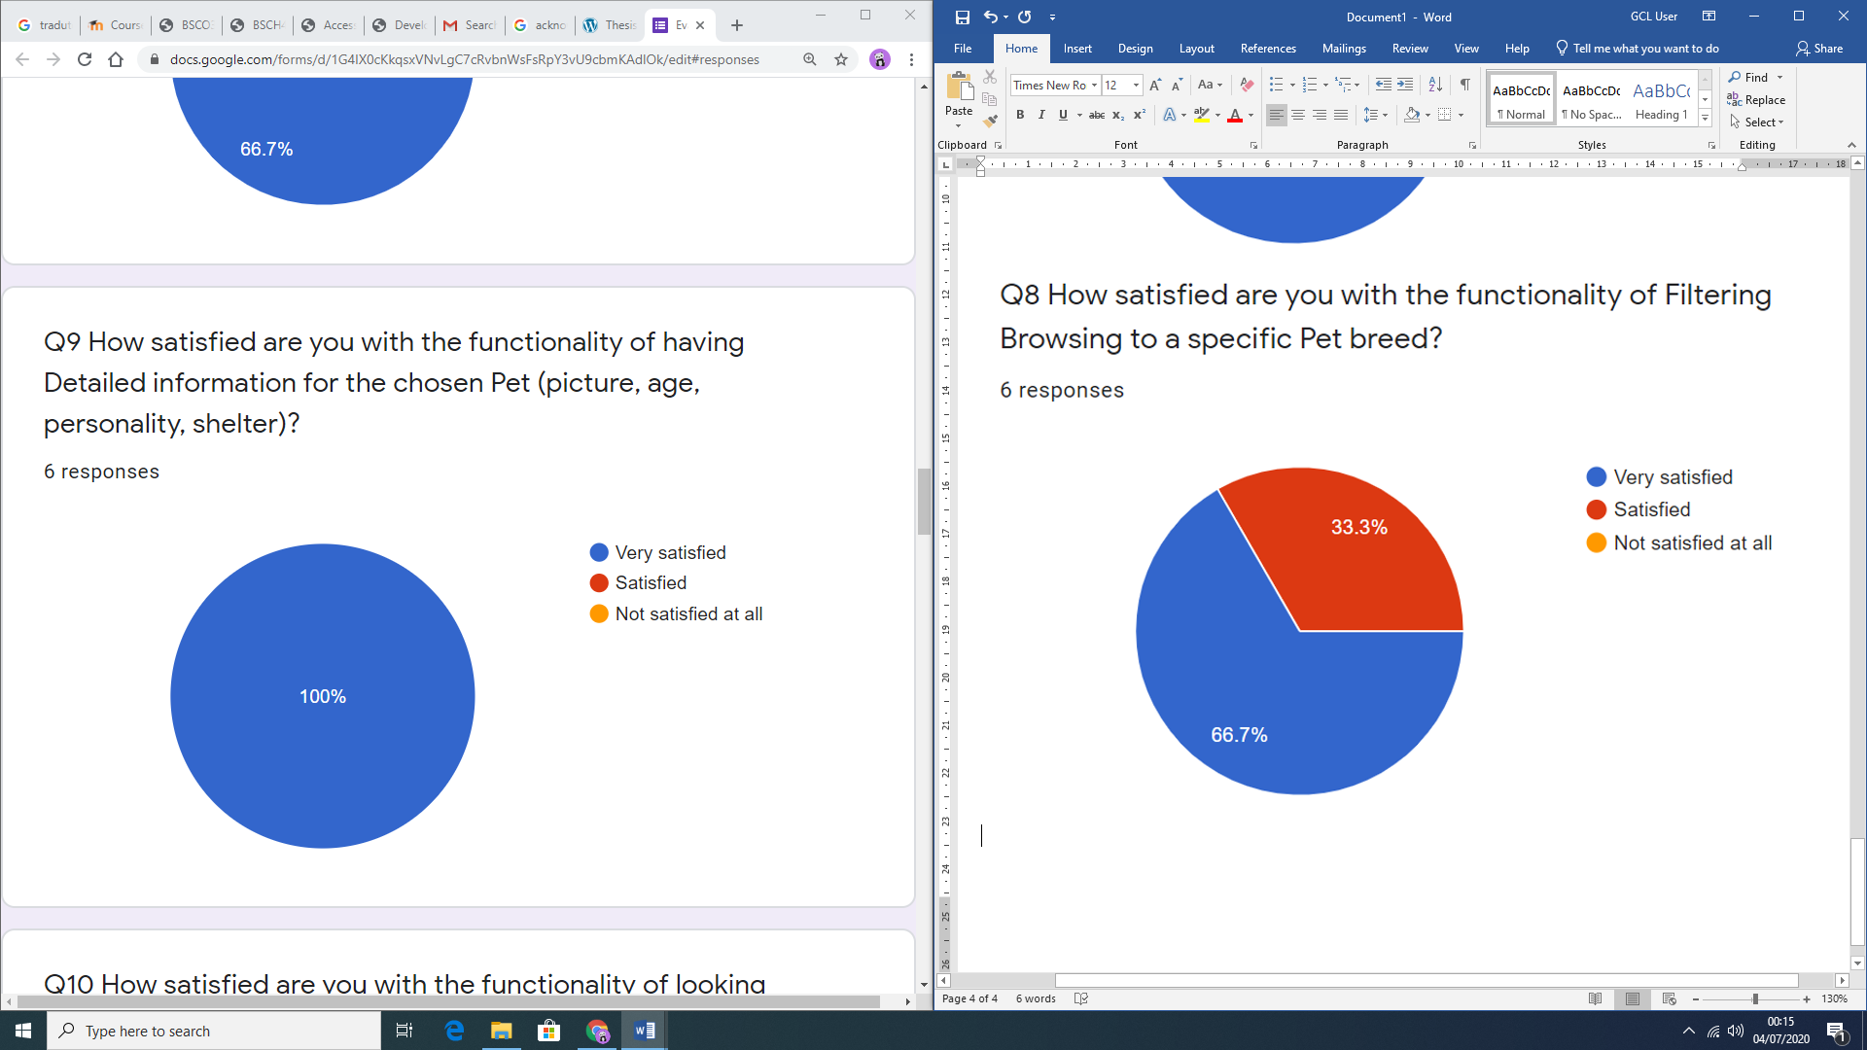
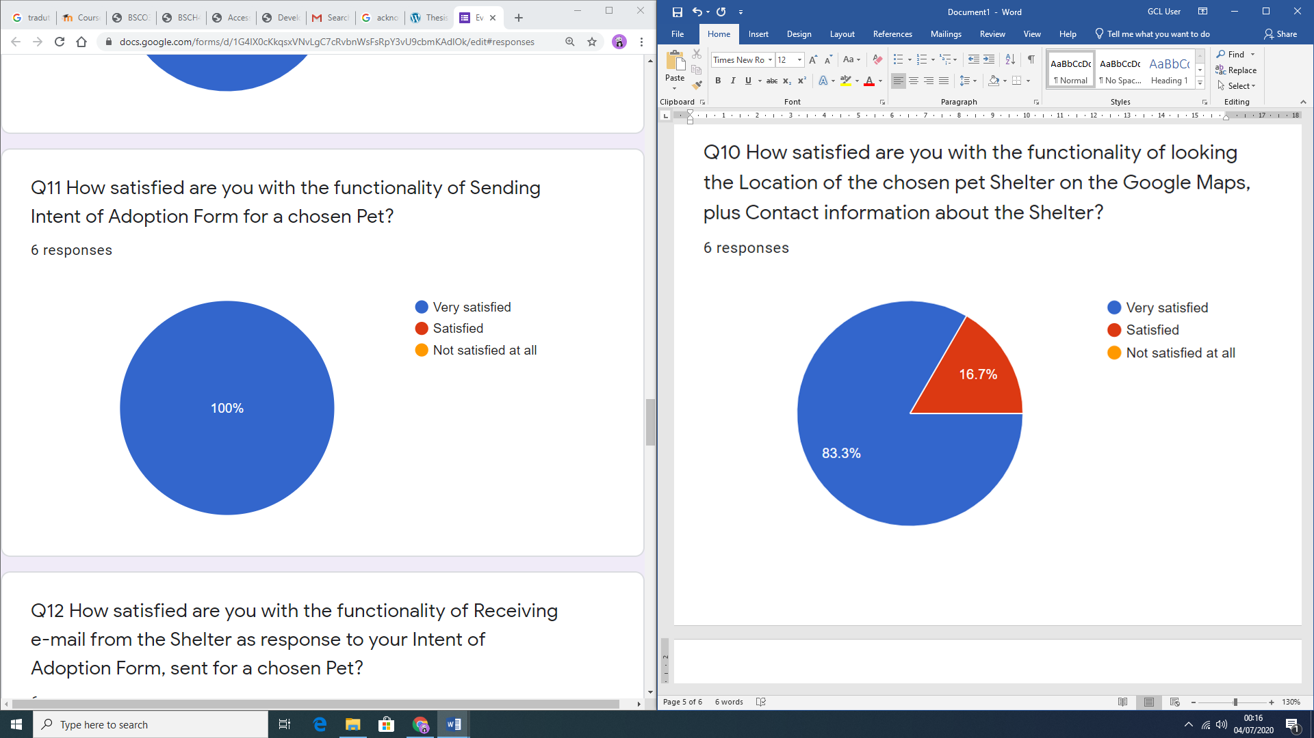
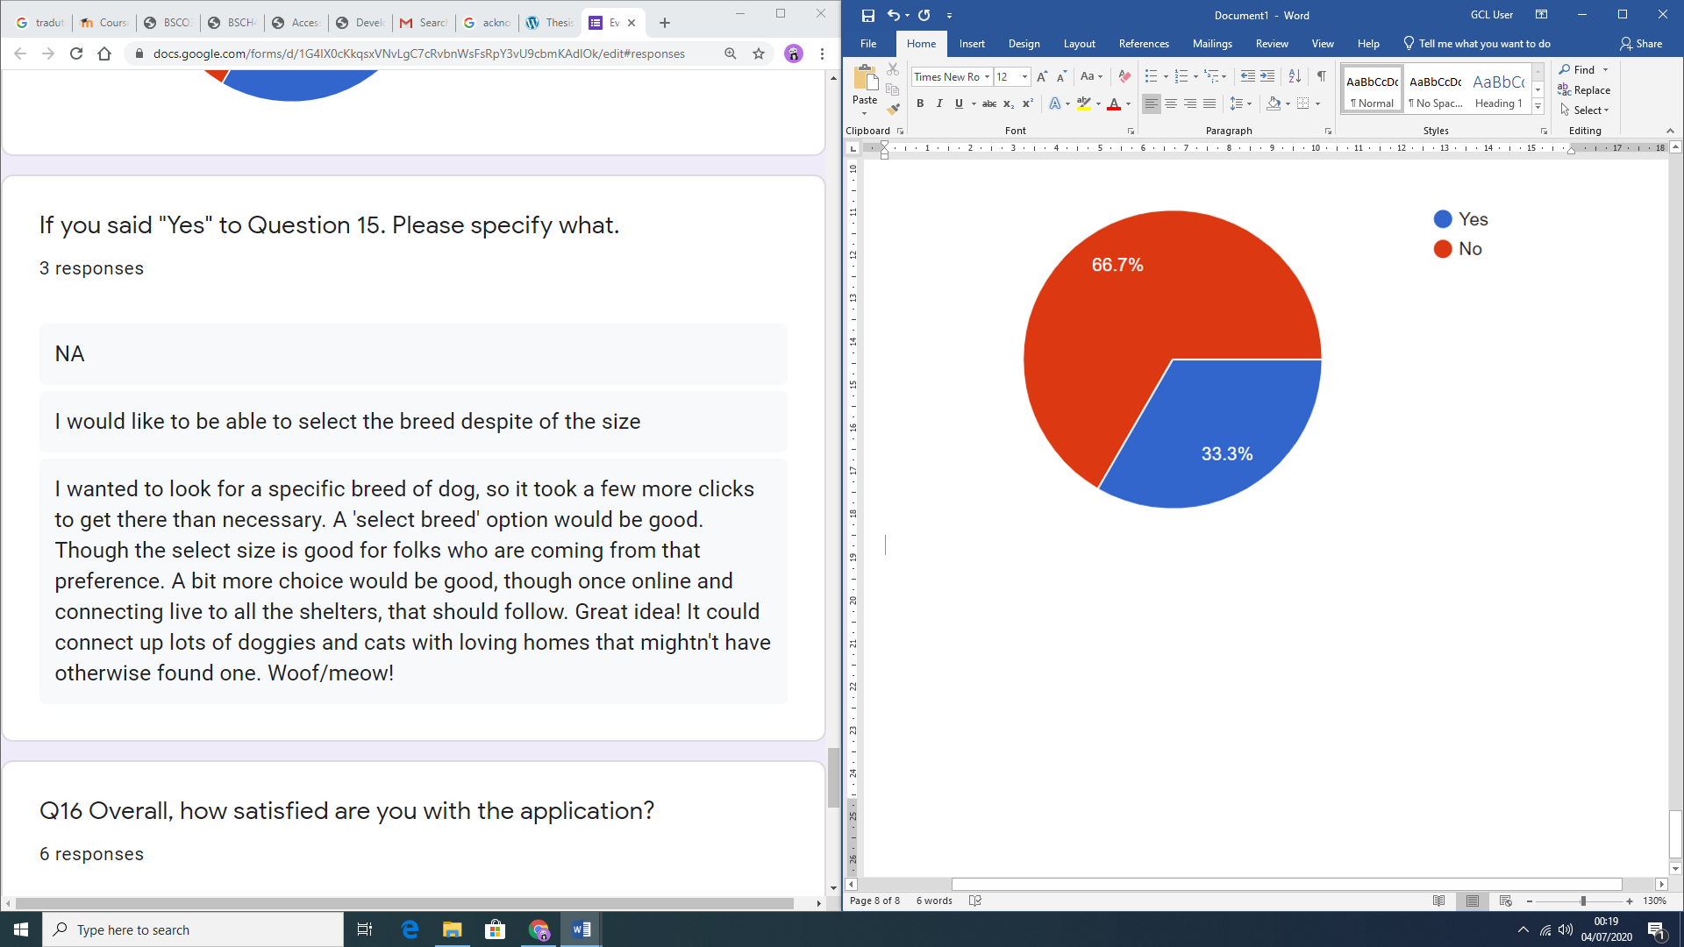
Project Evaluation 17 questions

Slide 26
Project Achievements
A Project Proposal was created, based on the performed initial Literature review (Secondary research) on the topic;
Primary (Quantitative) research with Initial Survey Questionnaire was performed;
The results obtained from the Survey were critically analysed and application requirements were specified, developing Conceptual Model for the application;
Using Storyboarding process, the Graphical User Interface for the functional specifications was designed, together with appropriate data structures;
Coding and thorough testing of the designed application was performed, as well as its integration with the Google Home IoT device;
The application was then evaluated by potential adopters, who were owning Smart Home (IoT) device (Google Home);
The Thesis document was completed with Conclusions and Scope for Future work on the project.

Slide 27
Contributions to IT field and Society
Development of a mobile application as a searching tool, integrated with Google Assistant for potential adopters to easily find the desired pet to be loved;
Simplified searching engine to find a pet.

Slide 28
Personal and Professional Achievements
Working as part of a team;
Time management skills;
Project development and management skills;
Overcoming unexpected fall-backs;
Applying theoretical knowledge into real work;
New development platforms;
Share and delegate responsibilities;
Help/share colleagues with obtained information;
Ability to provide alternatives when the planned alternative is not responding.

Slide 29
Conclusions
Application was developed with the potential adopters interface.
Strongly positive feedback from evaluation survey.
Benefits of this project are high for shelters and potential adopters but most importantly for the pets with the increasing on adoption rate and effectiveness on finding a pet faster and easier.

Slide 30
Scope for future work
Develop shelters’ interface;
Develop the high end solution to include a chatbox between potential adopters and shelter workers;
The filters should not be nested except for the category and breed;
The storage of the users’ password should not be stored on the database but with the Firebase Authentication platform to improve the security of the application.

Slide 31
User Manual
Application’s view
Open the application
Login
Registration
Login
Fill in email and password
Registration
Fill in name, Mobile Number, Email, Password
Filter the pets through Category, Size and Breed
Forgot password
Fill in email registered
Update details
Changeable information: mobile number and password
Send intention of adoption form for selected animal
Click on shelter’s name to see detailed information of the shelter
Google Assistant’s view
Call Hey Google, Talk to pet adoption app
Use commands to find the pet
I’d like to adopt a cat;
I want to adopt a large dog;
I would like a dog;
Provide the inputs asked by the assistant

Slide 32
Thank you!
Any Questions?

